Slide 1
7.0.Food & Nutrition
Executive Diploma in Culinary Arts & Hospitality Management

Slide 2
7.1. DEFINITION
NUTRITION: It is the study of food and health, it is the science and centers in foods, their nutrients and other chemical constituents and the effects the food on body processes and health.
NUTRIENTS: These are the chemical substances that found in the food that are used by the body for growth and health.
Nutrition, nourishment, or aliment refers to the nurturing of our body to keep it healthy and functioning as it is supposed to do. Nature has provided a variety of foods for man to consume and be healthy. We consume food for maintenance of health, growth and to develop greater resistance against infections.
Nutrition as a science was found by Lavoisier (the father of chemistry and also the father of nutrition) towards the end of 18nth century.
The science of nutrition is one of the youngest of the sciences.

Slide 3
DEFINITION
FOOD:
Food is the material consisting essentially of protein, carbohydrate, and fat used in the body of an organism to sustain growth, repair, and vital processes and to furnish energy; also: such material together with supplementary substances (as minerals, vitamins, and condiments)
NUTRITION:
Nutrition is an art and also a science. Nutrition is defined as “the science of foods, the nutrients and other substances, they are in action, interaction and balancing in relation to health and disease.”

Slide 4
DEFINITION
HEALTH:
Health is a state of complete physical, mental, and social well-being and not merely the absence of disease or infirmity. – World Health Organization
NURSING:
Nursing is "the unique function of the nurse is to assist he individual, sick or well, in the performance of those activities contributing to health or its recovery (or to peaceful death) that he would perform unaided if he had the necessary strength, will, or knowledge, and to do this in such a way as to strength, will or knowledge, and to do this is such a way as to help him gain independence as rapidly as possible". - Virgnia Henderson

Slide 5
7.2. IMPORTANCE OF NUTRITION
Promotes satisfactory growth
Prevents deficiency states
Prevents acute and chronic diseases
Promotes development of physiological and mental potential
Provides reserves for stress
Helps in maintaining normal metabolism
Decreases the risk of hypoglycemia, azotemia and hyperbilirubianaema

Slide 6
7.3. CLASSES OF NUTRIENTS
Proteins
Carbohydrates
Fats
Vitamins
Minerals
Water

Slide 7
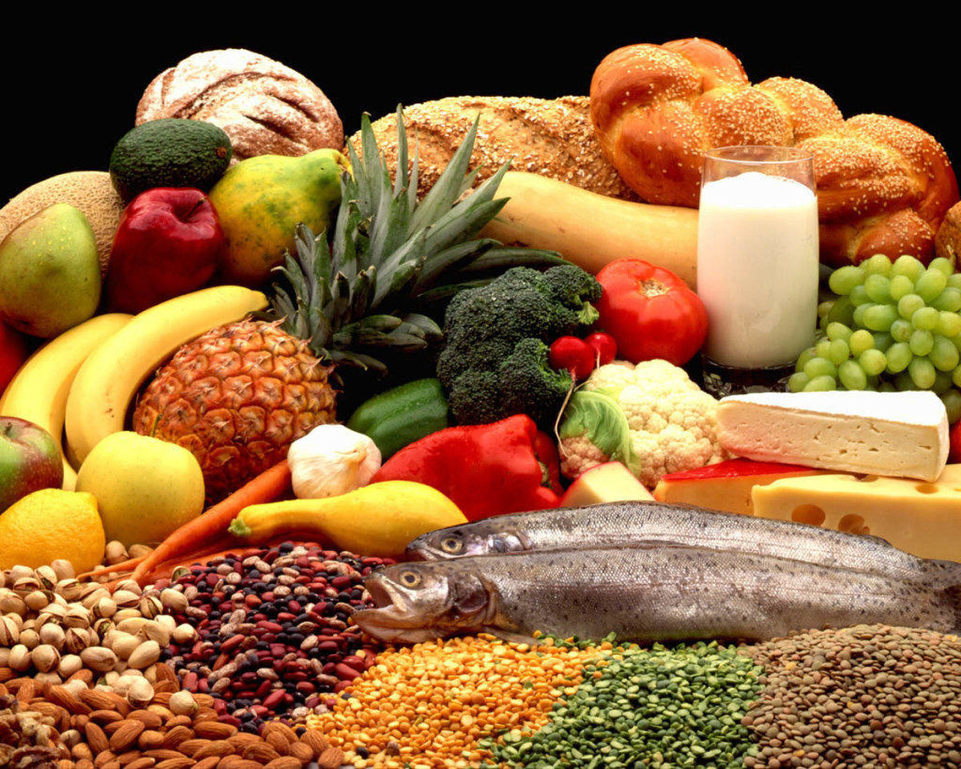
7.3.1. PROTIENS
Used for replacement and repair of body cells and for growth.
Made up of amino acids.
Found in eggs, milk, cheese and meat.
Essential amino acids must be supplied.

Slide 8
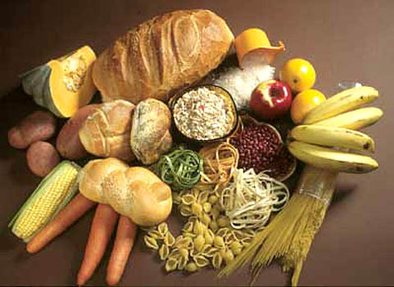
7.3.2. CARBOHYDRATES
Its is the main source of energy for our body.
These are energy giving nutrients that include sugars, starches and fibers.
Sugars are simplest form of carbohydrates.
Starches are more complex carbohydrates that can be broken down into sugars.
1 gram of carbohydrates equals to 4 calories.

Slide 9
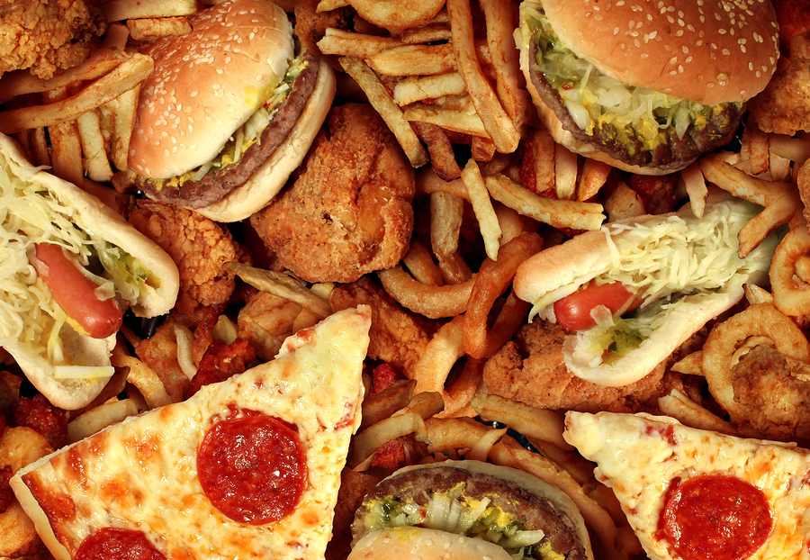
7.3.3. FATS
Fats are body’s main form of long term energy storage.
Fats are large molecules made up of fatty acids and glycerol.
These are long chains of carbon atoms attaches to hydrogen atoms.
These are classified by the types of fatty acids they contain.

Slide 10
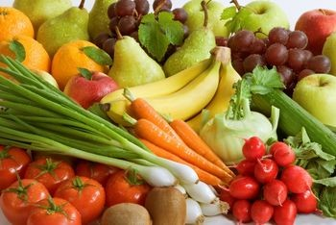
7.3.4. VITAMINS
Proteins are made up of amino acids, which are used in building and repairing structures in the body.
Proteins are also needed for hormones, enzymes and other essential molecules.

Slide 11
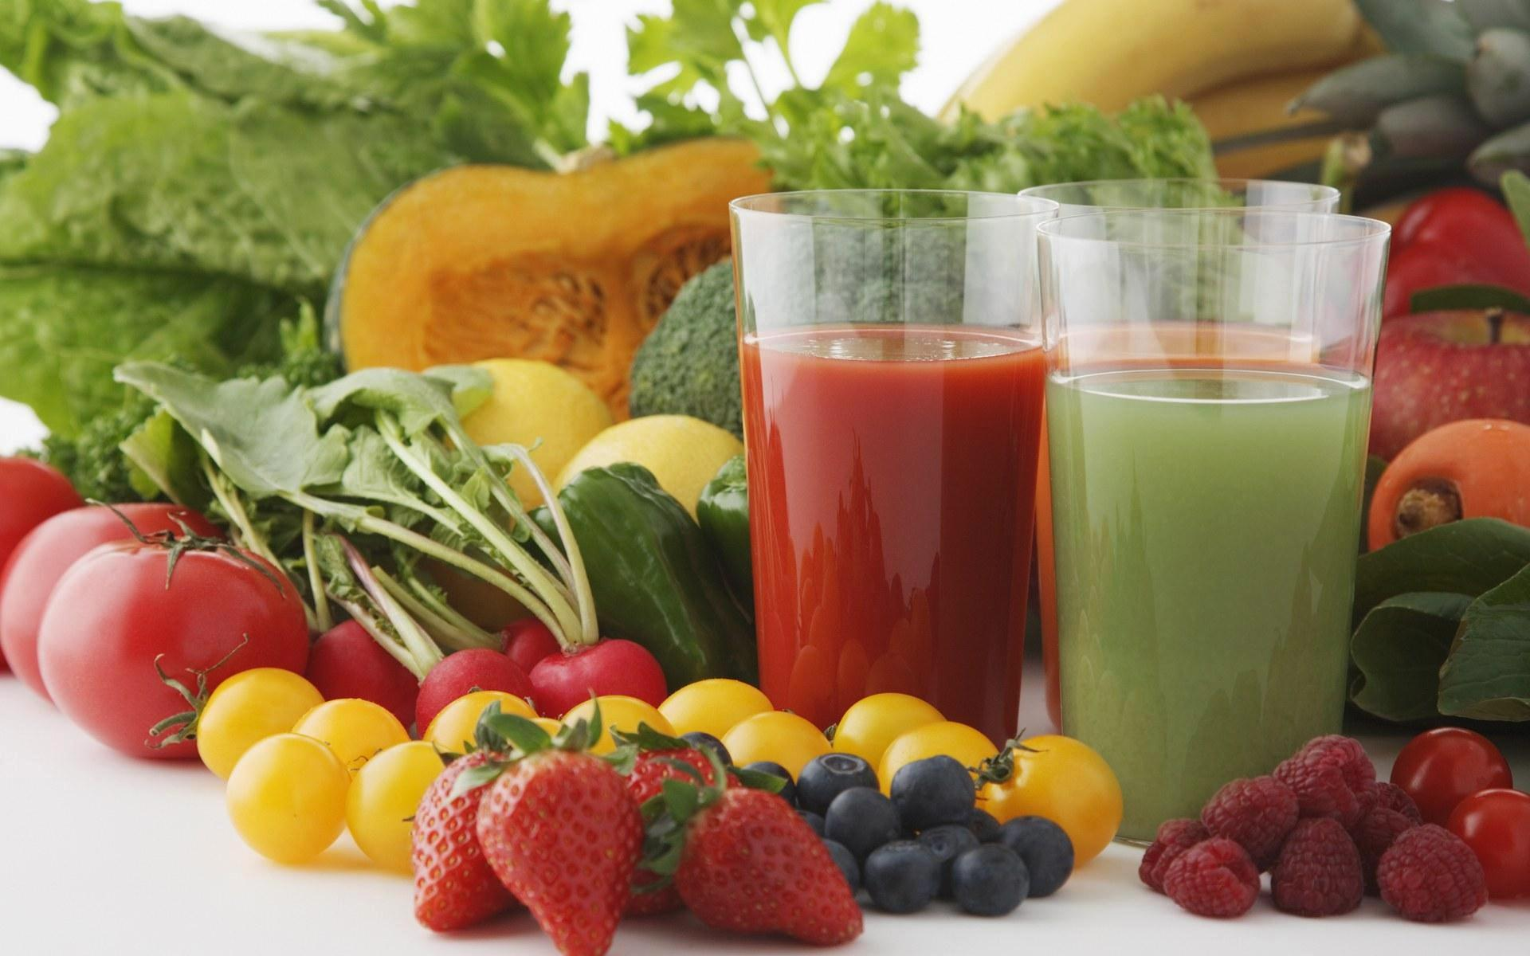
7.3.5. MINERALS
These are inorganic nutrients.
Regulates many chemical reaction in our body.
Calcium and phosphorous are used most by the body.

Slide 12

7.3.6. WATER
Required for our survival.
Cells need water to carry out their work.
most nutrients your body needs must be dissolved in water.
The human body is about 60 percent water.

Slide 13
7.4. CHANGING CONCEPTS OF NUTRITION
The essential nutrients, proteins, fats and carbohydrates have been recognized in the early 19nth century.
Specific Nutritional disorders were identified such as protein energy mal nutrition, Vitamin A deficiency, Endemic goiter, Nutritional Anemia, Nutritional blindness etc. and measures were found to prevent and control these disorders.
The science of Nutrition was extended to other fields like agriculture, animal husbandry, economics and sociology. This led to “green revolution” and “white revolution” and increased food production.

Slide 14
CHANGING CONCEPTS OF NUTRITION
During recent years the science of nutrition has extended to Nutritional epidemiology.
The old concept of “the health sector alone is responsible for all nutritional problems” is now realized that a broad multi factorial and integrated approach of sectors is essential to solve today’s nutritional problems.
The main objectives of the National Health Policy are:
Promotion of proper nutritional status of individual, families & communities
Prevention of nutritional deficiency disorders.
Maintenance of the health of the individuals
Supplementation of essential nutrients to all the vulnerable groups
IEC related to healthy Nutrition.

Slide 15
7.5. RELATION BETWEEN NUTRITION AND HEALTH
Achievement of optimal growth and development, reflecting the full expression of one’ s genetic potential.
Maintenance of the structural integrity and functional efficiency of body tissues necessary for an active and productive use.
Mental well-being
Ability to withstand the inevitable process of aging with minimal disability and functional impairment.
Ability to combat diseases such as
a. resisting infections (immunocompetence)
b. preventing the onset of degenerative diseases
c. resisting the effect of environmental toxins/ pollutants

Slide 16
7.6. FUNCTIONS OF FOOD AND NUTRITION
1. Good Nutrition Provides Energy
2. Good Nutrition Provides Raw Materials
3. The "Little Helpers"
4. Good Nutrition Means Good Health
5. Prevention of Infections
6. Body development and maintenance
7. Nourishing and caring
8. Social functions of food
9. Psychological functions of food

Slide 17
7.7. STATES OF NUTRITION
Optimal Nutrition:
The term "Optimum Nutrition" can be defined as eating the right amounts of nutrients on a proper schedule to achieve the best performance and the longest possible lifetime in good health, assuming that external negative influences like accidents and infectious diseases can be avoided.
Mal Nutrition:
Malnutrition is a broad term which refers to both undernutrition (sub nutrition) and over nutrition. Individuals are malnourished, or suffer from under nutrition if their diet does not provide them with adequate calories and protein for maintenance and growth, or they cannot fully utilize the food they eat due to illness.
Over Nutrition:
Over nutrition is frequent or habitual over consumption of nutrients by eating too much food to the point that it becomes dangerous to the health.
Under Nutrition:
Under nutrition is the opposite of over nutrition, meaning that it is a nutrient deficiency from not eating enough food.

Slide 18
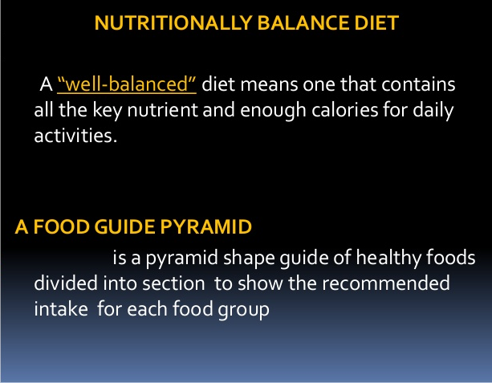

Slide 19
